Slide 1

Naive Bayes
Summer Internship- 2026
Name: Varsha Sangwan
Supervisor: Prof. Millie Pant
Mentor: Ms. Riya Applied Mathematics & Scientific Computing
Indian Institute of Technology Roorkee

Slide 2

Table Of Contents
Introduction to Naive Bayes
Conditional Probability
The independence assumption
Bayes’ Theorem
The Naive Bayes Formula
Workflow of Naive Bayes
Types of Naive Bayes
Applications of Naive Bayes
Practical Example
References

Slide 3
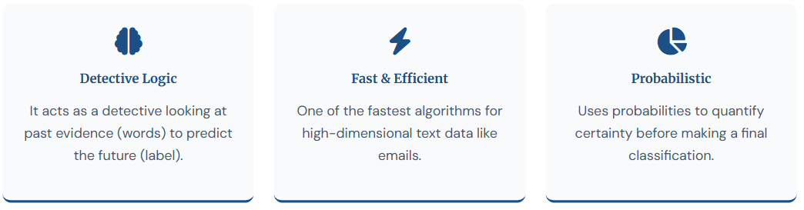
Introduction
Naive Bayes is a probabilistic machine learning algorithm based on Bayes' Theorem. It is primarily used for classification tasks, where the goal is to assign a class label to a given input based on its features. Despite its simplicity, Naive Bayes is widely used in real-world applications such as spam filtering, sentiment analysis, and document classification.

Slide 4
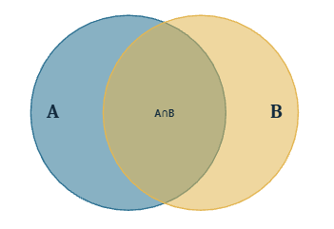

Conditional Probability
Conditional probability measures the likelihood of event A occurring, given that event B has already occurred. It is the mathematical backbone that Bayes’ Theorem – and therefore Naive Bayes - built on
P(A|B) is Probability of A given B

Slide 5
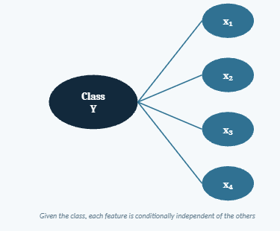

The Independence Assumption
Naïve bayes assumes every feature contributes independently to the outcome ,given the class. Knowing the value of one feature tells you nothing about another feature – this is the “Naive” part of algorithm.
Reduces a joint complex probability into a simple product of individual probabilities.
Makes the model computationally cheap – only per-feature statistics are needed.
The assumption is rarely 100%,yet Naive Bayes still classifies accurately in practice

Slide 6
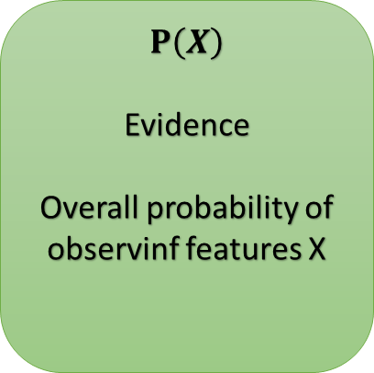
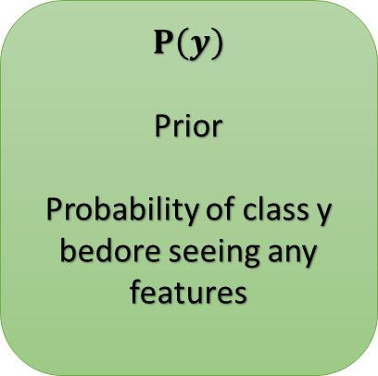
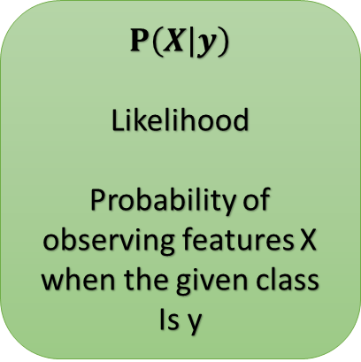
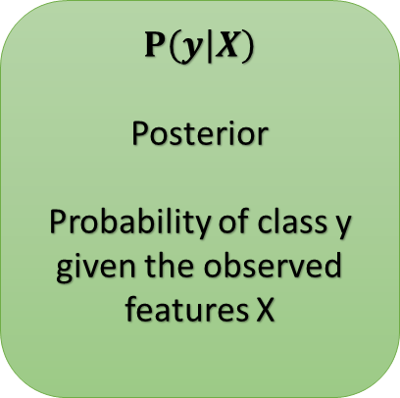
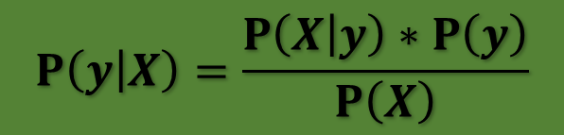
Bayes’ Theorem
$$P\left(y | X\right)=\frac{P\left(X | y\right)∗P\left(y\right)}{P\left(X\right)}$$
$$P\left(y | X\right)$$
Posterior
Probability of class y given the observed features X
$$P\left(X | y\right)$$
Likelihood
Probability of observing features X when the given class
Is y
$$P\left(y\right)$$
Prior
Probability of class y bedore seeing any features
$$P\left(X\right)$$
Evidence
Overall probability of observinf features X

Slide 7
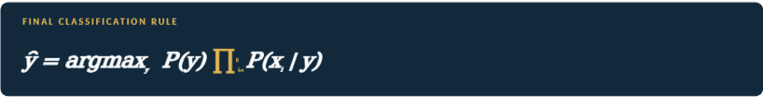
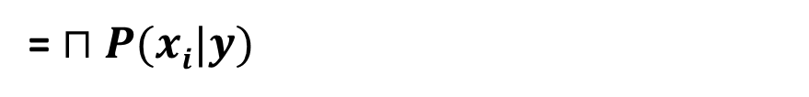

The Naive Bayes Formula
Substituting the independence assumption into Bayes theorem gives the Naïve Bayes Formula. Since , P(X) is the same for every class , it can be dropped and replaced with a proportionality
$P\left(y | x1,…,xn\right)= P\left(y\right)∗P(x1,…,xn|y)/P(x1,…,xn)$
Apply Independence :
$$P(x1,…,xn|y)$$
= $⊓P(xi|y)$

Slide 8
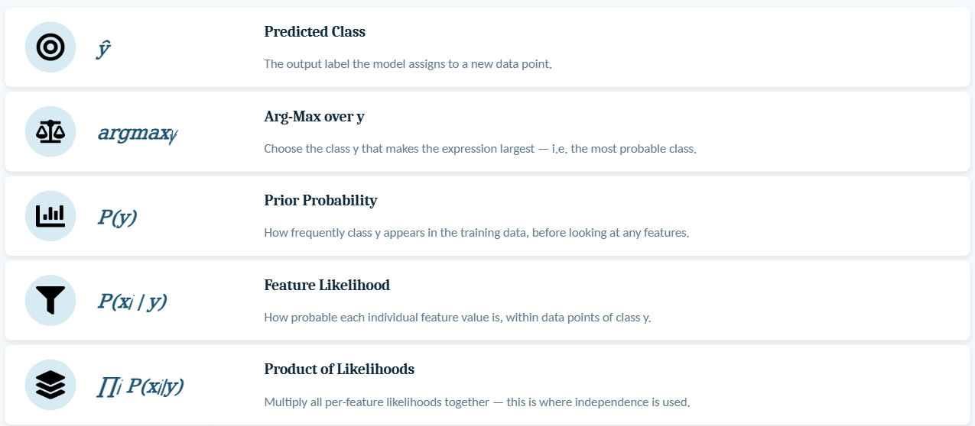
Explaination of the formula

Slide 9
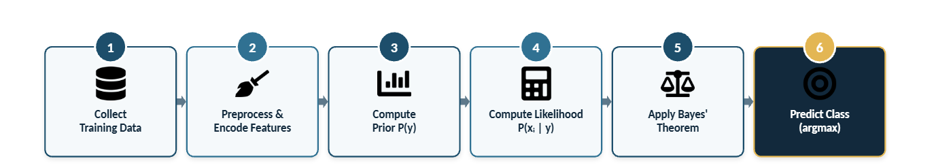
Workflow Of Naive Bayes

Slide 10
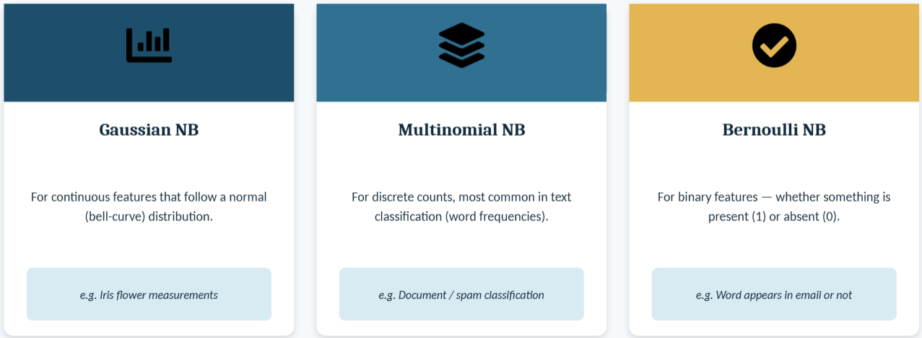
Types of Naive Bayes Classifier

Slide 11
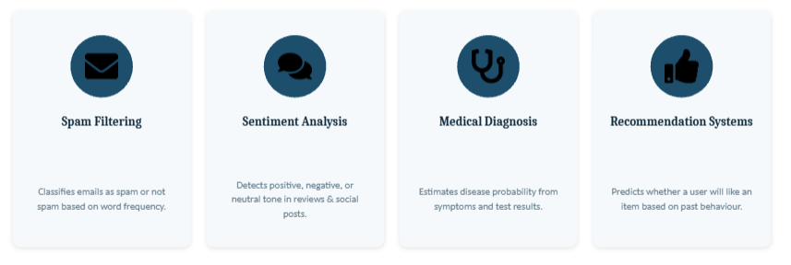
Applications of Naive Bayes

Slide 12
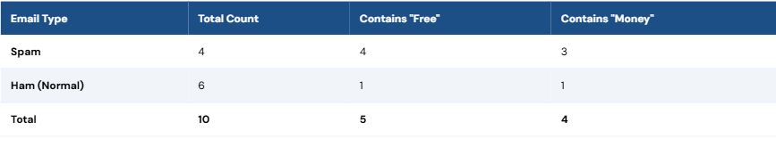
Practical Example
Training Set: 10 Historical Emails
Email Type | Total Count | Contains "Free" | Contains "Money"
Spam | 4 | 4 | 3
Ham (Normal) | 6 | 1 | 1
Total | 10 | 5 | 4
New Email Arrives: "Free Money"

Slide 13

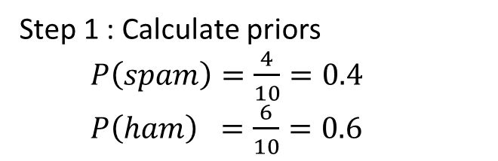
Practical Example
Step 1 : Calculate priors
$P\left(spam\right)=\frac{4}{10}=0.4$
$P\left(ham\right) =\frac{6}{10}=0.6$
Step 2 : Calculate the likelihoods
for spam class
Probability of "Free" given it's Spam
$$P\left(\text{Free} | spam\right)=\frac{3}{4}=0.75$$
Probability of "Money" given it's Spam
$P\left(\text{money} | spam\right)=\frac{2}{4}=0.50$
For the ham class
Probability of "Free" given it's Ham
$P\left(\text{Free} | ham\right)=\frac{1}{6}=0.167$
Probability of "Money" given it's Ham
$$P\left(\text{money} | ham\right)=\frac{1}{6}=0.167$$

Slide 14


Practical Example
Step 3 : Apply the "Naive" Independence Multiplication
Calculating the Spam Score
$score\left(spam\right)=0.4∗0.75∗0.50$ = $0.15$
Calculating the ham score
$score\left(ham\right)=0.6∗0.167∗0.167=0.0167$
Step 4 : Normalize to get percentage
Calculate final spam probability
$P\left(spam | \text{Free} \text{money}\right)=\frac{0.15}{0.1667}=0.90\left(90\%\right)$
Calculate final ham probability
$P\left(ham | \text{Free} \text{money}\right)=\frac{0.0167}{0.1667}=0.10\left(10\%\right)$
Output
The Final Verdict
Because 90% is significantly higher than 10%, the Naive Bayes algorithm confidently classifies the email "Free Money" as Spam.

Slide 15
References
scikit-learn developers. "Naive Bayes." scikit-learn documentation. https://scikit-learn.org/stable/modules/naive_bayes.html
Wikipedia contributors. "Naive Bayes classifier." Wikipedia. https://en.wikipedia.org/wiki/Naive_Bayes_classifier

Slide 16


